Slide 1
ANT COLONY OPTIMIZATION
To Solve Travelling Salesman Problem

Slide 2
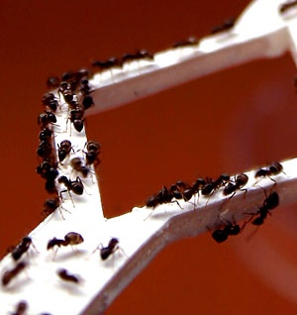
What is Ant Colony Optimization ?
A probabilistic technique for solving computational problems which can be reduced to finding good paths through graphs.
Each ant tries to find a route
between its nest and a
food source.

Slide 3
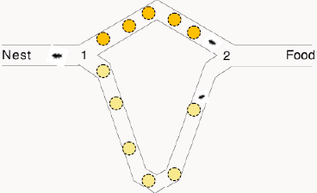
Overview of the concept -
The behaviour of each ant in nature –
Moves randomly at first, laying down a pheromone trail.
If food is found, return to the
nest laying down a pheromone
trail.
If pheromone is found, with
some increased probability follow the pheromone trail.
Once back at the nest, go out again in search of food.

Slide 4
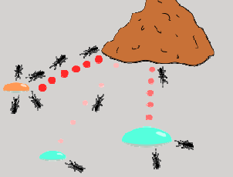
Pheromones ?
A pheromone is a chemical an ant produces which changes the behavior of other ants.
Pheromones evaporate over time, such that unless they are reinforced by more ants, the pheromones will disappear.
More pheromone on path
increases probability of path
being followed.

Slide 5

History -
Initially proposed by Marco Dorigo in 1992 in his PhD thesis.
The algorithm was aiming to search for an
optimal path in a graph, based on the
behavior of ants seeking a path between
their colony and a source of food.
The original idea has since diversified to solve a wider class of numerical problems.

Slide 6
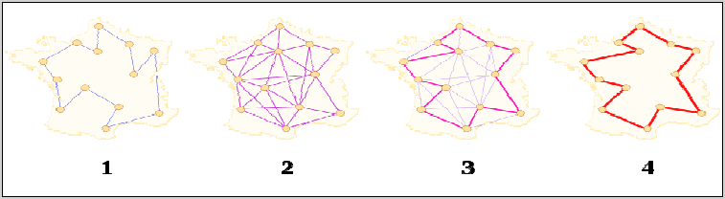
Traveling Salesman Problem
In the Traveling Salesman Problem (TSP) a salesman visits ‘n’ cities once.
Problem : What is the shortest possible route ?

Slide 7
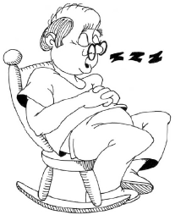
Solutions ?
Brute Force Method :
Create permutations for all N cities
within the TSP.
Iteratively check all distances.
Branch And Bound Method :
Searches for locally optimal solutions.
CAN IT BE OPTIMIZED MORE ?

Slide 8
Problem Specification -
For a collection of cities and the cost of travel between each pair of them, the Traveling Salesman Problem is used to find the cheapest way of visiting all of the cities and returning to the starting point.
Implement the above problem using Ant Colony Optimization technique.
Given ‘n’ nodes and ‘m’ ants improve the performance of TSP using Ant Colony Optimization.

Slide 9
The ACO Meta-heuristic
ACO
Set Parameters, Initialize pheromone trails.
Activities -
Construct Ant Solutions.
Update Pheromones.
Virtual trail accumulated on path segments.

Slide 10
Transformation
Nature | Program
Natural Habitat | Graph (nodes and edges)
Nest and food | Nodes in the graph: start and destination
Ants | Agents, our artificial ants
Visibility | The reciprocal of distance, η
Pheromones | Artificial pheromones, τ
Foraging behavior | Random walk through graph (guided by pheromones)

Slide 11
Construct Ant Solutions -
An ant will move from node i to node j with probability –
P_{i,j} = (Г_{i,j} ^{α}) (η_{i,j}^{β}) / ∑ (Г_{i,j} ^{α}) (η_{i,j}^{β}) ,
where,
Г_{i,j} is the amount of pheromone on edge i, j.
α is a parameter to control the influence of Г_{i,j} .
η_{i,j} is the desirability of edge i, j (typically 1 / d_{i,j}).
β is a parameter to control the influence of η_{i,j.}

Slide 12
Update Pheromones -
Amount of pheromone is updated according to the equation –
Г_{i,j} = (1 – ρ) Г_{i,j} + Δ Г_{i,j} ,
where,
Г_{i,j} is the amount of pheromone on a given edge i, j.
ρ is the rate of pheromone evaporation.
Δ Г_{i,j} is the amount of pheromone deposited, typically given by –
Δ Г_{i,j}^{k} = 1 / L_{k} , if ant k travels on edge i, j.
0 , otherwise.
where L_{k} is the cost of the k^{th} ant’s tour (typically length).

Slide 13
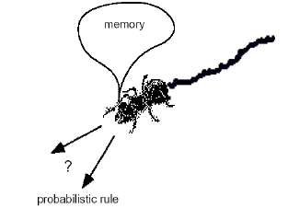
ACO Algorithm for TSP
Pseudo code :
initialize all edges to (small) initial pheromone level τ0;
place each ant on a randomly chosen city;
for each iteration do:
do while each ant has not completed its tour:
for each ant do:
move ant to next city by the probability function
end;
end;
for each ant with a complete tour do:
evaporate pheromones;
apply pheromone update;
if (ant k’s tour is shorter than the global solution)
update global solution to ant k’s tour
end;
end;

Slide 14
Work Done Till Mid-Sem
Understood the concept of the Travelling Salesman Problem.
Implemented the Travelling Salesman Problem using Branch and Bound approach.
Familiarized with the basic elements of Ant Colony Optimization (ACO) technique of solving combinatorial problems.
Implemented the Travelling Salesman Problem using Ant Colony Optimization (ACO) meta-heuristics.

Slide 15
Work To Be Done By End-Sem
Comparative Study of the performances of the Ant Colony Optimization (ACO) implementation and the Branch and Bound approach of solving the Travelling Salesman Problem on the basis of time complexity analysis.
To improve the performance of the Ant Colony Optimization (ACO) implementation of the Travelling Salesman Problem.

Slide 16
References -
[1] Marco Dorigo and Thomas Stutzle, Ant Colony Optimization. Cambridge, MIT Press, 2004.
[2] Marco Dorigo and Gianni Di Caro, Ant Colony Optimization: A New Meta-Heuristic, IEEE Press.
[3] Dorigo M. & L.M. Gambardella (1997). Ant Colony System: A Cooperative Learning Approach to the Traveling Salesman Problem. IEEE Transactions on Evolutionary Computation, 1, 1, in press.
[4] Wikipedia
Other internet sources.

Slide 17
Thank You
Compiled By –
Rajdeep Singh (IIT2011137)
Ishan Adhaulia (IIT2011133)
Vinay Pratap (IIT2011111)
Ashish Kumar (IIT2011169)
Abhishek Kumar (IIT2011038)

